Slide 1
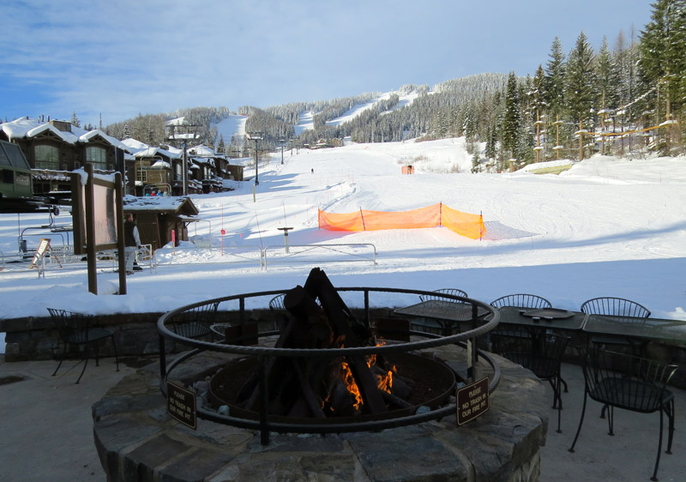
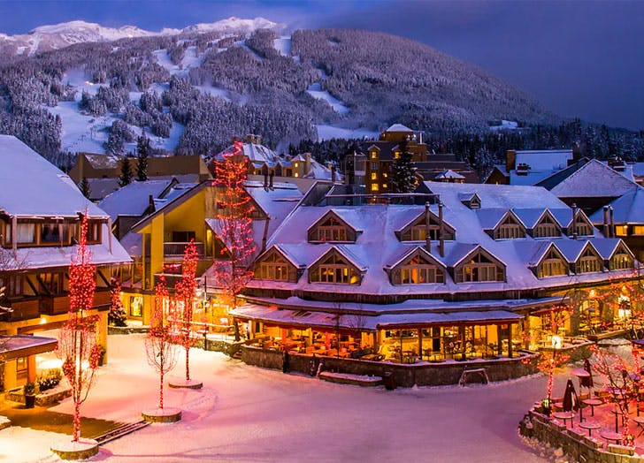
BIG MOUNTAIN SKI RESORT
Ticket Pricing Model

Slide 2
Purpose:
To provide guidance for ticket pricing and future facility investment
To build a predictive pricing model for ski resort tickets within their market segment.
Number of facilities at resorts
To provide insight into what facilities are most important to visitors.
Which facilities they are most likely to pay for.

Slide 3
Key Findings:
Permanent closure of up to 10 of the least used runs
This can close up to 5 runs, which results in drop in ticket prices and revenue
Increase vertical drop by 150ft and addition of a chair lift
This justifies the ticket price increase of $8.46 and additional revenue of $15 million (approx. )
Increase vertical drop by 150ft with the addition of 2 acres of snow making
This justifies the ticket price increase of $9.75 and additional revenue of $17.06 million
Increase in the longest run by 0.2 miles (boasting the longest run) and additional snow making of 4 acres
This results in no change in ticket price
Recommendation:
Increase vertical drop by 150ft with the addition of a chair lift and 2 acres of snow making.
This justifies the ticket price increase of $10.59 and will generate additional revenue of $18.5 million/year

Slide 4
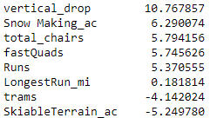
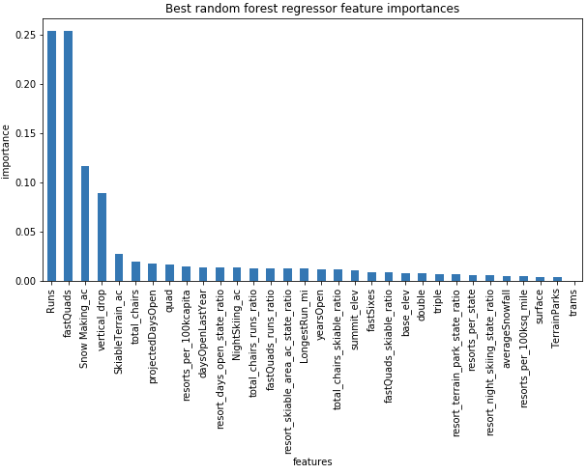
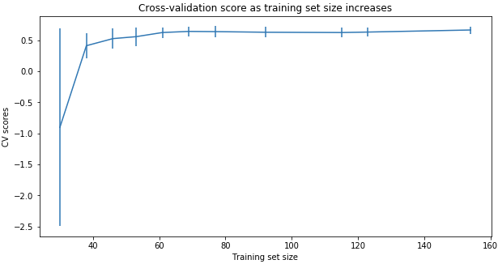
Modeling Comparison:
Linear Regression Model
MAE_mean : 10.499; std : 1.622
Random Forest Regression Model
MAE_mean : 9.659; std : 1.349
vs
Cross-Validation Score
Notes:
The random forest model has a lower cross-validation mean absolute error (MAE errors between paired observations expressing the same phenomenon) by almost $1. It also exhibits less variability. Verifying performance on the test set produces performance consistent with the cross-validation results. (10.499032338015294, 1.6220608976799664) vs. (9.649477185159107, 1.505326312688125)
This shows that you seem to have plenty of data. There's an initial rapid improvement in model scores as one would expect, but it's essentially levelled off by around a sample size of 40-50

Slide 5
Modeling Data
Modelled ticket price: $94.22 vs. Actual ticket price: $81.00
MAE = $10.39 suggests there is room for an increase.
Pricing Assumptions:
Other resorts set their prices according to the market.
Big Mountain appears to be charging much less than prediction suggests:
Is Big Mountain undercharging?
Are other resorts Overpriced?
Is our model lacking some key data
Operating Costs

Slide 6
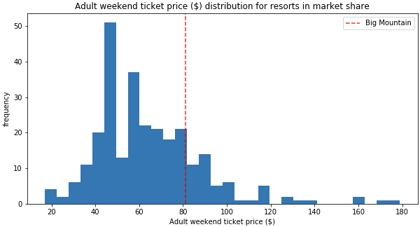
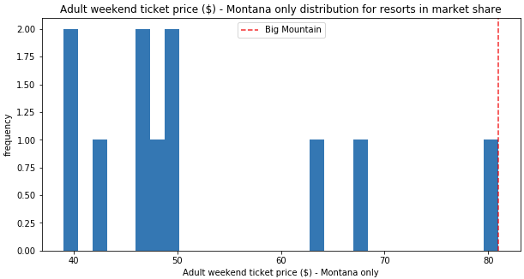
Big Mountain Resort Ticket Prices

Slide 7
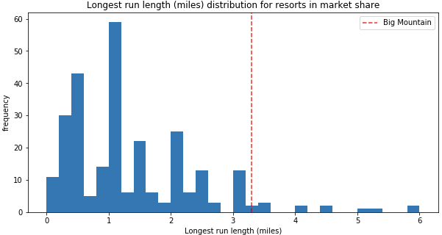
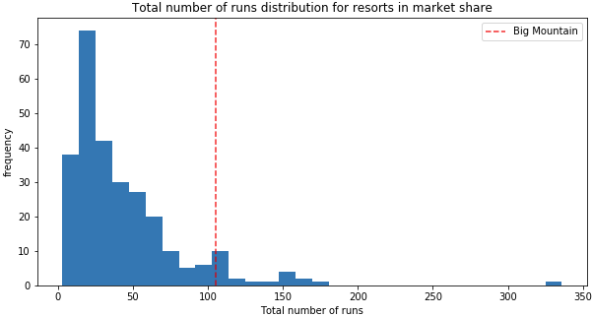
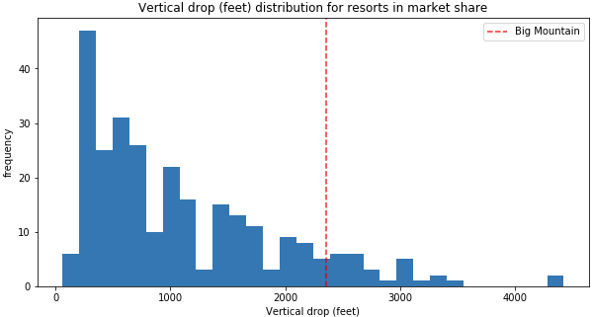
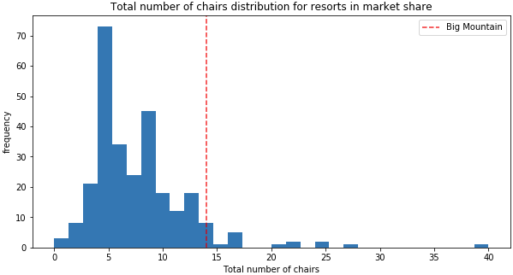
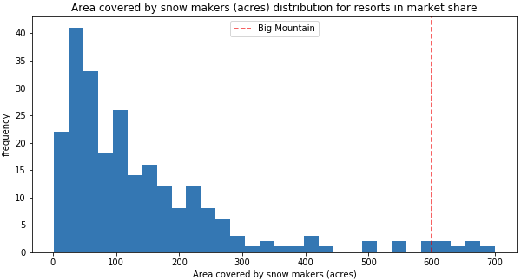
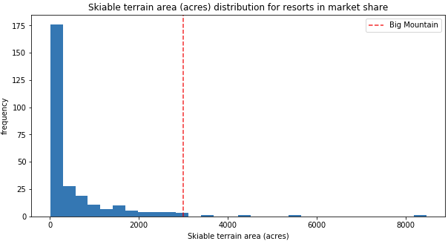
Feature Comparisons

Slide 8
Summary
Big Mountain Currently ranks among the top resorts
Skiable terrain
Number of Runs
Snow making capacity
Number of Chairs
Proposed Scenerios:
Closure of 5 least used runs
Increase vertical drop with and without snowmaking
Increase longest run with snowmaking
By increasing the vertical drop either with or without snowmaking will provide the opportunity to increase revenues by $15-$17 million, however the increase cost of tickets must be considered.

